Slide 1



Coffee Shop Sales Data Analysis wer bi).
Uncover key insights on your coffee shop's performance, from revenue trends to product category contributions.
by pramod nemagouda

Slide 2

Introduction: Business Context and Objectives
The main objective of the project is to gain valuable insights from their sales data and make data-driven decisions to improve performance and profitability.
Data Sources and Tools
MySQL:For data quering,cleaning and management. Power Bi: Dynamic dashboard creation and interactive data visualization. Both MySQL and Power Bi allowed for thorough cross validation of data, ensuring accuracy and reliability in addressing the project’s problem statements.

Slide 3
MY SQL
STEPS FOR MY SQL
• Data Walkthrough
• Raw data file preparation
• Creating Database
• Importing File
• Cleaning Imported File
• Changing Data Types
• Firing SQL Queries for Business Requirements
• Storing Results
• Preparing SQL Documents

Slide 4
PROBLEM STATEMENT:
KPI'S REQUIREMENTS
• Calculate the total sales for each respective month.
1.Total Sales Analysis:
• Determine the month-on-month increase or decrease in sales.
• Calculate the difference in sales between the selected month and the previous month.
2. Total Orders Analysis:
• Calculate the total number of orders for each respective month.
• Determine the month-on-month increase or decrease in the number of orders.
• Calculate the difference in the number of orders between the selected month and the previous month.
3. Total Quantity Sold Analysis:
• Calculate the total quantity sold for each respective month.
• Determine the month-on-month increase or decrease in the total quantity sold.
• Calculate the difference in the total quantity sold between the selected month and the previous month.

Slide 5

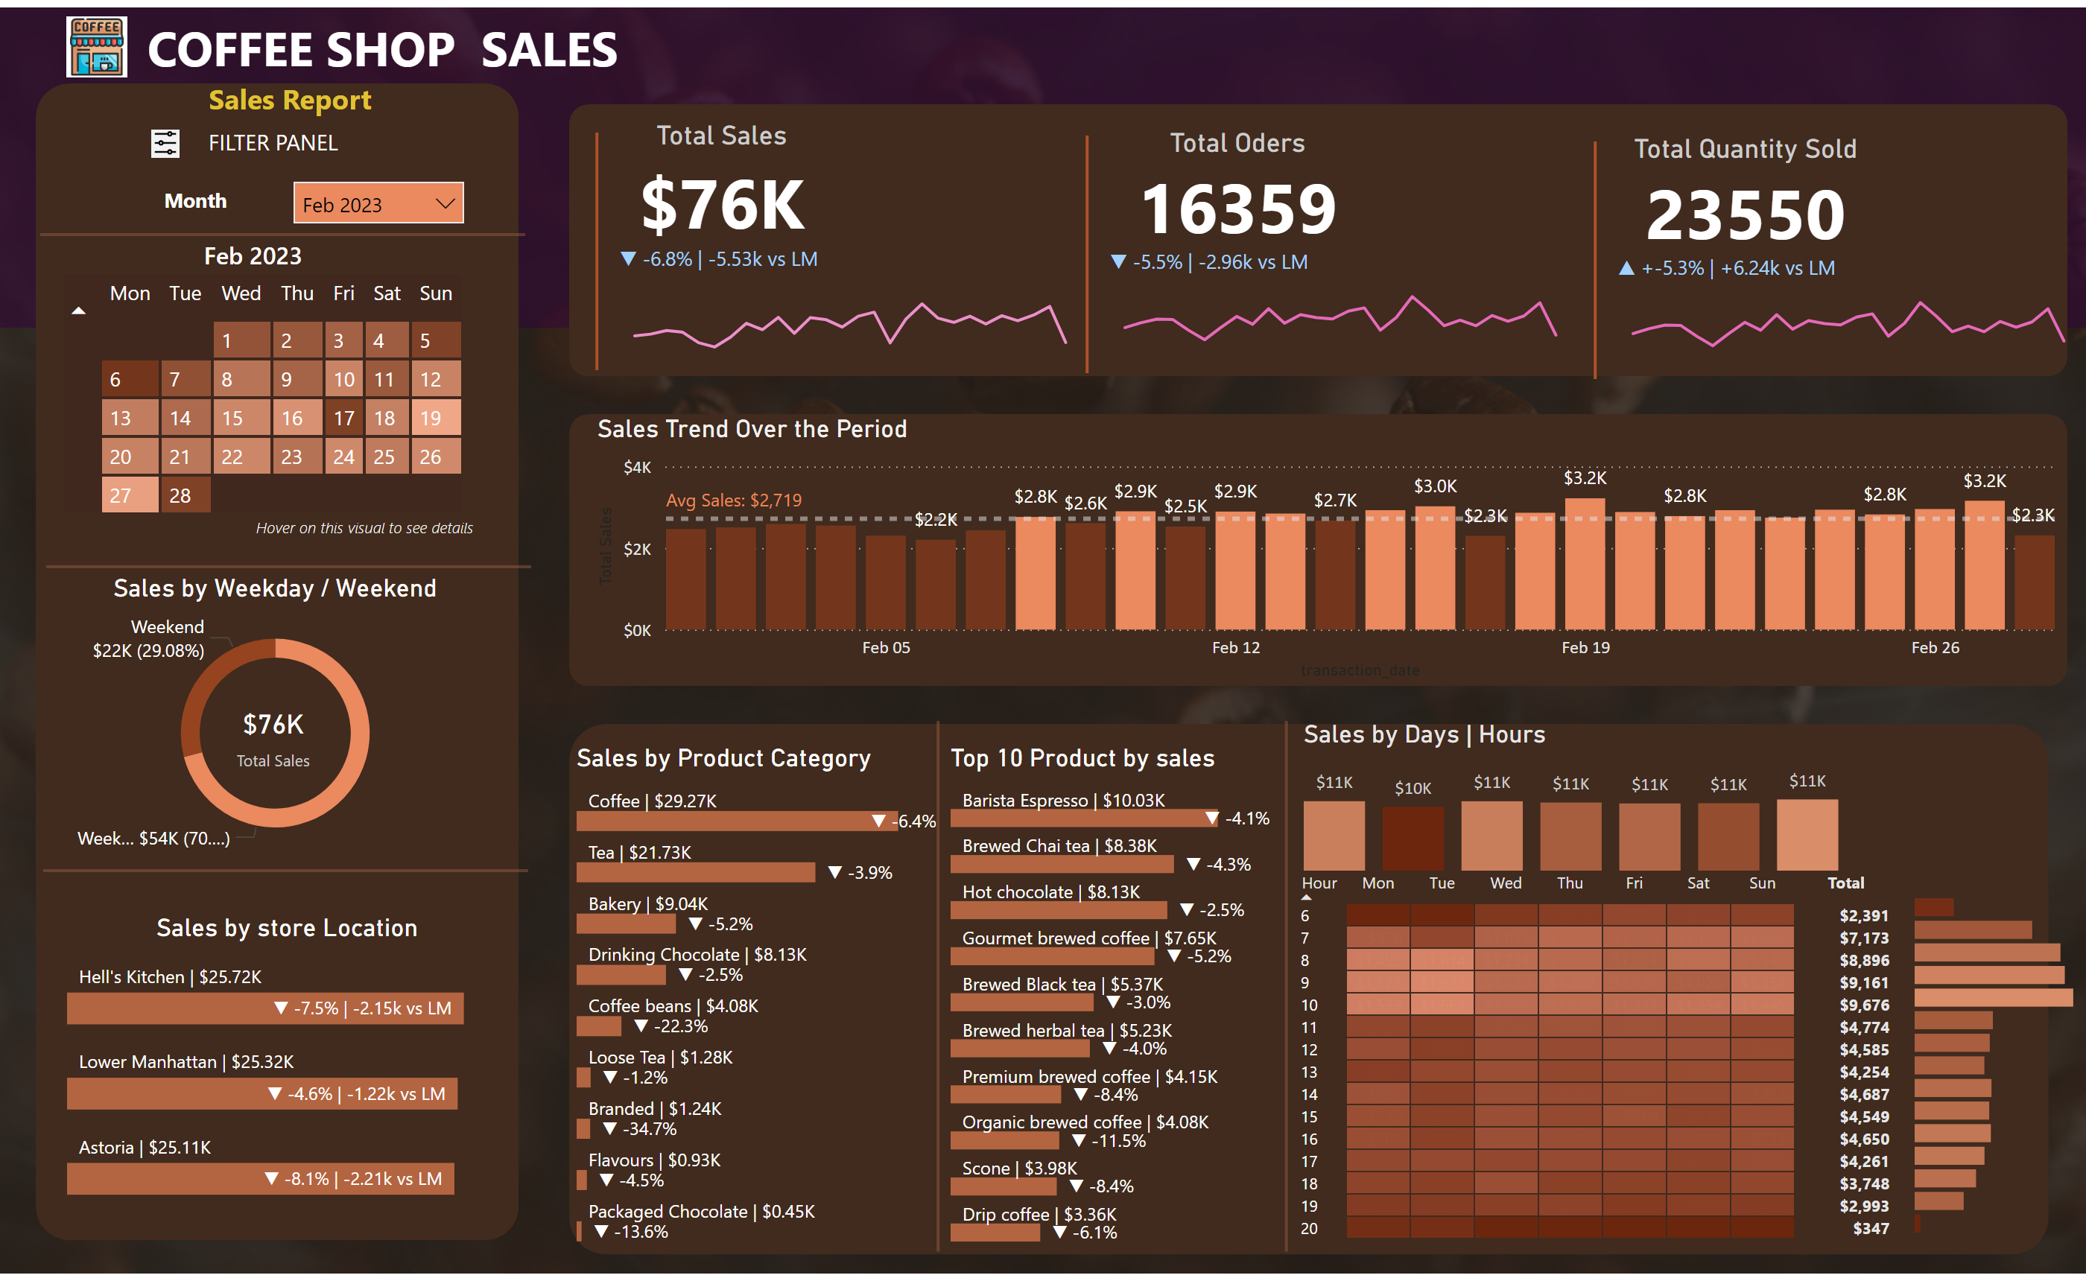

Coffee ☕ Sales report
View in Power BI

Slide 6
CHARTS REQUIREMENTS
1. Calendar Heat Map:
• Implement a calendar heat map that dynamically adjusts based on the selected month from a slicer.
• Each day on the calendar will be color-coded to represent sales volume, with darker shades indicating higher
sales.
• Implement tooltips to display detailed metrics (Sales, Orders, Quantity) when hovering over a specific day.
2. Sales Analysis by Weekdays and Weekends:
• Segment sales data into weekdays and weekends to analyze performance variations.
• Provide insights into whether sales patterns differ significantly between weekdays and weekends.
3. Sales Analysis by Store Location:
• Visualize sales data by different store locations.
• Include month-over-month (MoM) difference metrics based on the selected month in the slicer.
• Highlight MoM sales increase or decrease for each store location to identify trends.
4. Daily Sales Analysis with Average Line:
• Display daily sales for the selected month with a line chart.
• Incorporate an average line on the chart to represent the average daily sales.
• Highlight bars exceeding or falling below the average sales to identify exceptional sales days.
5. Sales Analysis by Product Category:
Analyze sales performance across different product categories.
• Provide insights into which product categories contribute the most to overall sales.
6. Top 10 Products by Sales:
• Identify and display the top 10 products based on sales volume.
Allow users to quickly visualize the best-performing products in terms of sales.
7. Sales Analysis by Days and Hours:
• Utilize a heat map to visualize sales patterns by days and hours.
• Implement tooltips to display detailed metrics (Sales, Orders, Quantity) when hovering over a specific day-hour.

Slide 7
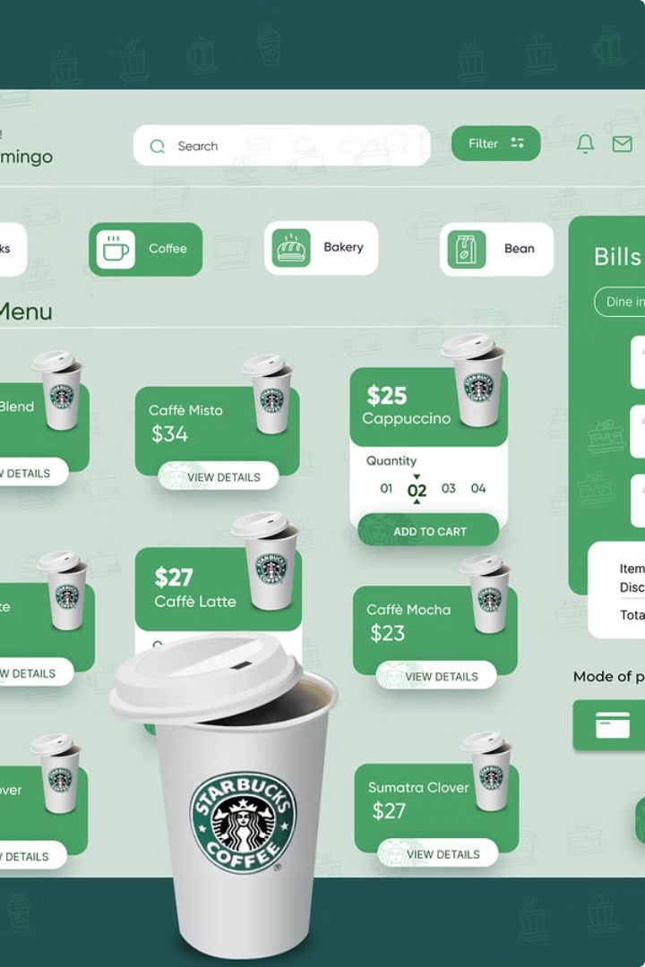
Technical Stacks:
MY SQL
Microsoft Power BI
Advance DAX Codes
Power BI Techniques
Key Findings
Creating a Date Table
6. How to use Date/Time functions
→ Total Sales Revenue → Daily Sales → Average Sales per Day → Sales by Product Category → Sales by Time of Day → Sales by Day of Week → Average Transaction Value → Sales Growth Rate

Slide 8
THANK YOU

